Slide 1



A Presentation on
Enhancements
To
proxyMITY
Ankit Yadu
Bhanumathi Ponneru
Lavina Sachdev
Neha Jindal

Slide 2
proxyMITY
“proxyMITY” serves as a “proxy”.
It provides virtual closeness (proximity) without the actual classroom.
proxyMITY on Aakash Tablet helps users to get access to quality lectures of reputed teachers, for effective personalized learning.
Users have the flexibility of studying anytime, anywhere, and at their own place.

Slide 3
Scope of the Project
This is mainly a video app but mainly intended for students of various disciplines.
It also provides an interface to various e-learning sites ( Nptel and Coursera ).
They have the flexibility of studying anytime, anywhere, and at their own place.

Slide 4
Features
Tree functionality
Bookmark
Play video with subtitles

Slide 5
Snapshots

Slide 6
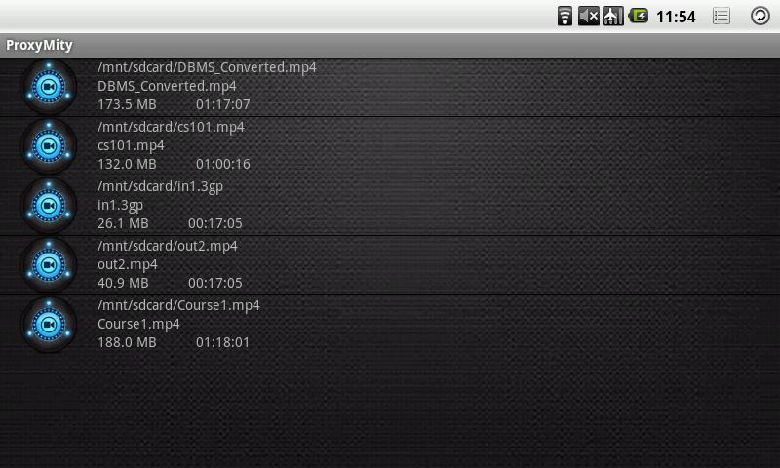

Slide 7
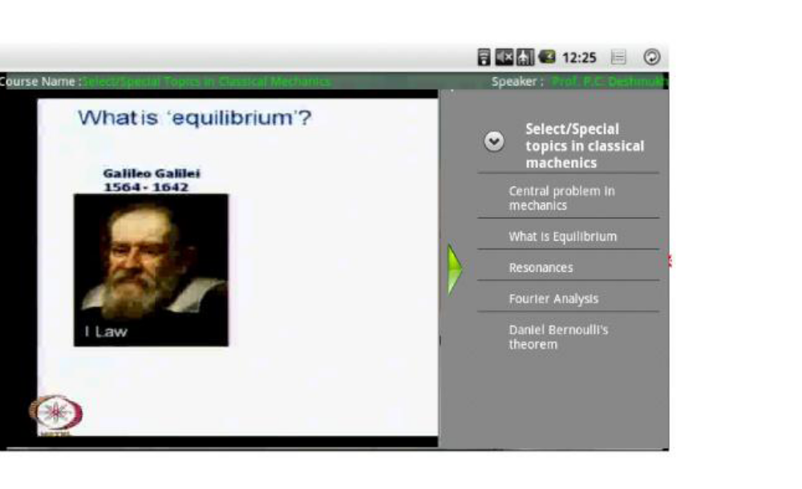

Slide 8
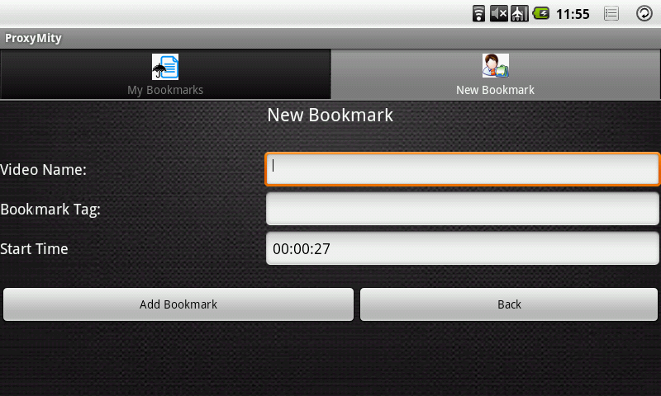

Slide 9
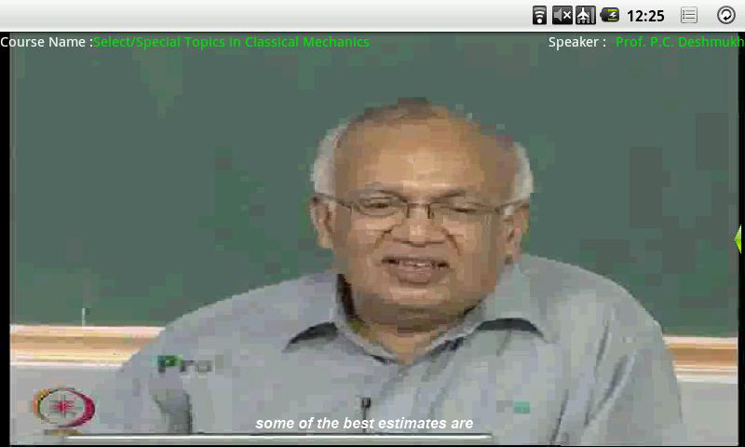

Slide 10
Enhancements to proxyMITY
Drag and Drop feature
Transcripts
Quiz session

Slide 11
Different Versions

Slide 12
proxyMITY-sdcard
List of lectures stored in SD-Card or pendrive can be viewed in this version.

Slide 13
proxyMITY Wi-Fi
Lectures stored on server can be viewed.
By entering the ip-address of the server user can easily connect and view the lecture videos

Slide 14
Challenges Faced
Adapting to different work culture
Open source technology
Real world problems

Slide 15
Thank You

